Slide 1



Do Existing Logic Models for Science and Technology Development Programs Build a Theory of Change?
American Evaluation Association Conference
November 3, 2011
Gretchen B. Jordan
Sandia National Laboratories
gbjorda@sandia.gov
gretchen.jordan@comcast.net
Parts of work presented here was completed for the U.S. DOE by Sandia National Laboratories, Albuquerque, New Mexico. Opinions expressed are solely those of the author.

Slide 2
Program Theory and Theory of Change
Program theory is a theory or model that describes the underlying assumptions about how a program is expected to work; how the program causes the intended or observed outcomes.
A theory of change is both a program theory and an implementation theory -- the expected steps in the implementation of the program, an explanation for why program customers will follow through after the program so that outcomes not totally under the program’s control will be achieved. (Weiss)

Slide 3
Why do we care?
- program improvement
- evaluation synthesis
- attribution

Slide 4
The logic model and the program can be revised to reflect new information.
Food reseach
Participants buy
institut:
Mentor to assist
subsidized
Program
in the process
product
operator
development
assistance
Goal:Improv
Participants learn
ed product
Criteria for
Seminars on
new product
Participants
develop-
selection of
product
development
employ new
ment
Strong linkage
participants
development
methods
methods
Network among
Exchange of
Improved
Participants
participants
experiences
organization of
among the
product
participants
development
BEFORE
Vision:
Improved
competitiv
Food reseach
Criteria for
Improved
eness
institut:
selecting the
Mentor to assist
organization of
Program
mentors
in the process
product
operator
development
Goal:Improv
Participants learn
ed product
Willing
Seminars on
new product
Participants
develop-
participants
product
development
employ new
ment
development
methods
methods
Exchange of
Participants buy
Participants
experiences
subsidized
among the
product
participants
development
assistance
Source: Torvatn, 1999
AFTER
Network among
Vision:
participants
Improved
competitiv
eness

Slide 5
A Matrix for Assessing Attribution
Categories of Information Needed for Additionality Assessment | Technology Timeline (Stage of Research, Development, and Commercialization)→
 | Preliminary & detailed investigation | Develop components | Develop system | Validate/ demonstrate | Commer-cialize | Market Adoption
History of the technology
What DOE Did
What Others Did —Private Sector
What Others Did -Governments
The DOE Effect, Influence
Ruegg & Jordan, 2010

Slide 6
What’s the challenge?
- complex emergent system
- not well studied
-missing magic in the middle

Slide 7
A system is made up of:
Components (operating parts)
Relationships (links between components)
Actors
Institutions
Infrastructure
Actions, Interactions (networking)
Attributes (properties of the System’s dimensions)
‘
Source: Carlsson et al., 2002
Anna J. Wieczorek, Utrecht University

Slide 8
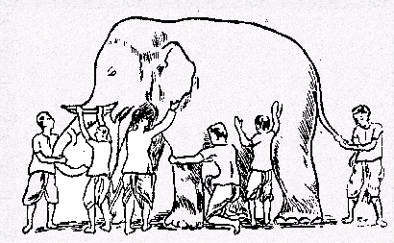
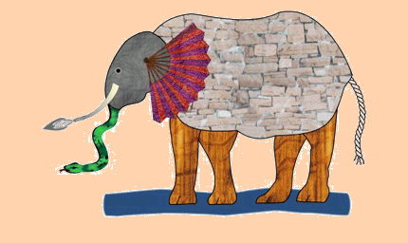
Parts are studied and understood better than the whole!
Source: Bhavya Lal, STPI, at AEA 2006
http://www.cs.unibo.it/schools/AC2005/docs/Bertinoro.ppt#266,11,The Blind Men and the Elephant

Slide 9

Frequently the “theory of change” associated with a program is not explicit
“I think you should
be more explicit
here in step two.”
Quote from a Sidney Harris cartoon
Intermediate
Outcomes
(through
customers)
Long-Term
Outcomes
& Problem
Solution
Resources
(Inputs)
Activities
Outputs
for
Customers
Reached
Short-Term
Outcomes
External Influences and Related Programs (mediating factors)

Slide 10
The hard part: intermediate outcomes
Source: Montague,
www.pmn.net
STATE
Strategic Objectives: e.g., wealth, health, safety, environmental protection
Action/Adoption (Sustained Change)
BEHAVIORAL CHANGE in partners, stakeholders, and target groups
The “miracle in the middle”
Active Partner Support
Ability/ Capacity
Awareness/ Acceptance
Legal/Business Climate
OPERATIONAL activities/outputs
Intensive Problem Solving/ R&D
Technical Specialist Support
Education
Information/ Advice
Awareness Building

Slide 11
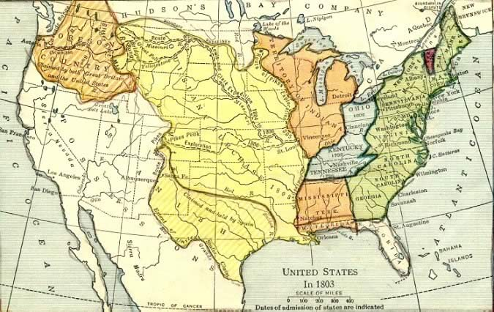
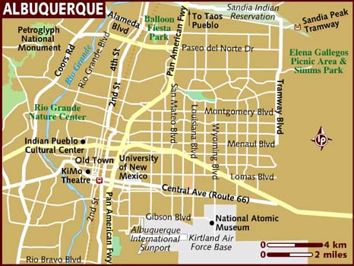
Different views: 30,000 feet vs. on the ground; new territory vs. settled; many years vs. election cycle

Slide 12
Components and Relationships
- science, technology, entrepreneurial activity
- actors, institutions arenas of RTD, market domains
- input-output-outcome format

Slide 13
Steps in the RTD Policy to Value Added Life Cycle
Joint industry-government planning
Market planning assistance
Strategic
Planning
Commercialization
Market
Development
Value
Added
Value
Added
Interface standards
Technology transfer (academic, government)
Entrepreneurial
Activity
Risk
Reduction
Acceptance test standards, national test facilities
Intellectual property rights,
tax incentives,
Proprietary
Technologies
Incubators
Infratechnologies
Direct funding of national labs, industry, consortia
Generic (Platform)
Technologies
National labs, direct funding of firms, consortia, universities
Science Base
Direct funding of national labs, universities
G. Tassey, The Technology Imperative, Edward Elgar, 2007

Slide 14
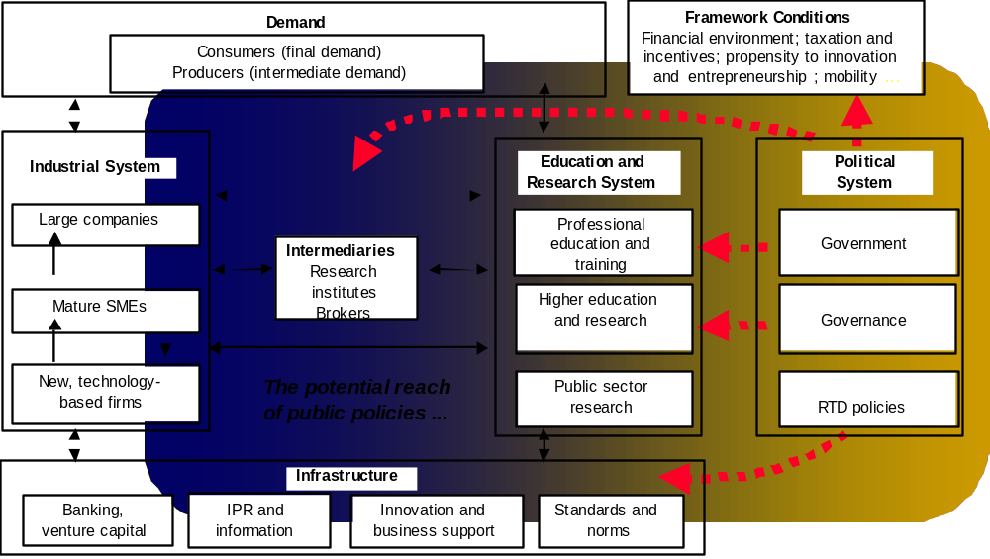

Actors/Institutions from a ‘national innovation systems’ perspective …
Source: Arnold and Kuhlmann, 2001

Slide 15
A more recent view of an innovation system
Quality
Research, Product refinement
Information Infrastructure
Research Agenda
Setting
Basic research
Utilization research
Business
Infrastructure
End User Demand
Problems.
Opportunities
Launch,
Production
Science Base,
R&D Capacity
Applied
research
End Outcomes,
System effects
Manufacturing
research
Government Policies
Development research
Generic & Infratech-nologies
Next generation
This generation
Source: G Jordan, 2010

Slide 16
Different perspectives on theories of change for diverse RTD initiatives

Slide 17
A macro level theory of RTD contribution to society
Technical and non-technical innovations
Immaterial capital
Creative individuals and communities
Market orientation
Labour
Economic growth
Education
Know-how
Increase in exports
Research
Knowledge
Improvement in
employment
Growth in productivity
Technology
Regional development
Innovation
Growth in well-being
Capital
Customer and user orientation
Pioneering markets
Open innovations
Source: Hyvarinen, Tekes

Slide 18
Logic Model of EPA Research
Adapted from Figure 4 – 1, page 54, Evaluating Research Efficiency in the U.S. Environmental Protection Agency, NRC, 2008)
SHORT-TERM & INTERMEDIATE OUTCOMES FROM LABORATORIES
INTERMEDIATE OUTCOMES FROM “USERS” OF LABORATORY RESEARCH
INPUTS
ACTIVITIES
OUTPUTS
MISSION-LEVEL OUTCOMES
Examples of Intramural
Activities:
Analytic services
Lab & field studies
Sample / data tracking & analysis
Information networks, management, and technology
Monitoring
Environmental & landscape characterization
Research
QA/QC
Program implementation
Health & safety
Facilities management
Project coordination
Multi-year plans
Knowledge Pool
Process Inputs:
Budget
Staff
Training
Laboratory Facilities
Examples:
Examples:
Clients:
EPA NPMs
Regional offices
State & local governments
Tribes
Industry
Business
First responders
Policy-makers
NGOs
Courts
Public
Federal partners
Examples:
Guidance
Regulations
Standards
FRM s
Integrated science assessment
Regulatory impact analysis
Risk management decisions e.g., remedial action plan
Compliance decisions
Accountability decisions
Protect Human Health & the Environment
Clean air & addressing global climate
Clean & safe water
Land preservation & restoration
Healthy communities & ecosystems
Compliance & environmental stewardship
Cross-goal strategies
Analytical data
Analysis of data from lab, field, landscape, and monitoring studies
Reports
Publications
QA/AC Reviews
Workshops
Conferences
Methods, models, and tools
Processes and technologies
Examples:
Data and knowledge provided for decision-making
New methods, models, and tools transferred to clients
Applications provided to clients
Risk assessments
Staff papers for decision-making
Assessments of condition & change in condition
Planning Inputs:
Regulatory Offices
National, state, local stakeholders
Risk assessments
Report On the Environment
Advice from Independent Expert Panels
Legislative requirements
Court decisions
Federal partners
Compliance reviews
Notes:
Primary Source Evaluating Research Efficiency in the U.S. Environmental Protection Agency. (NAS, 2008). Figure 4-1, “EPA research presented as a logic model,” page 54. Narrative accompanying figure, pages 52-56.
Related sources cited by NAS
Framework for the Review of Research Programs of the National Institute for Occupational Safety and Health (NAS, 2007) available from <http://www.cdc.gov/niosh/nas/pdfs/Framework081007.pdf> last accessed August 24, 2011.
Using Logic Models for Strategic Planning and Evaluation: Application to the National Center for Injury Prevention and Control. (Victoria Greenfield, Valerie Williams, and Elisa Eisman) RAND Corporation, 2005.

Slide 19
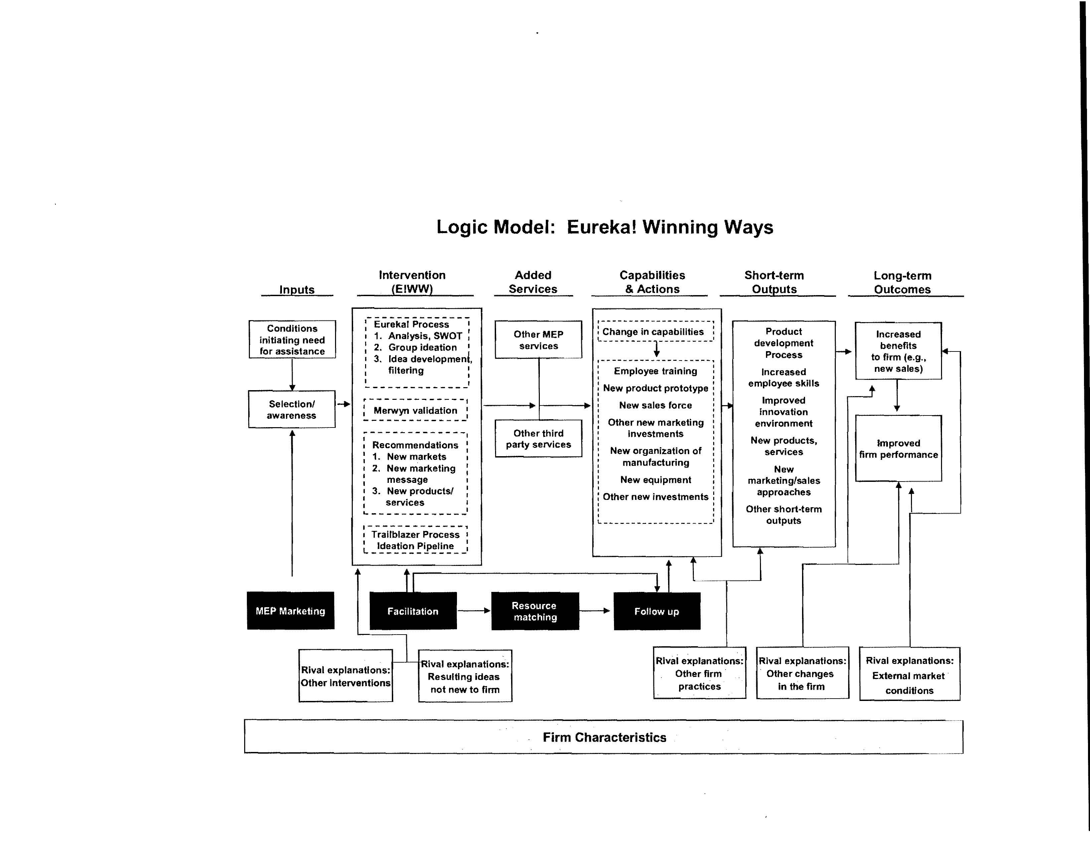
Source: P. Shapira, et al, for NIST MEP

Slide 20
U.S DOE Logic of Technology and Market Readiness
Draft 09/11/07
Technology Readiness Projects
Market Readiness Projects
Applied R&D
- Materials & devices
- 3rd gen. PV
- Advanced CPV
- Solar hydrogen
R&D on
Disruptive
Technologies
- CSP Towers
- Solar hybrid lighting
System Development
- 1st & 2nd Generation PV
- Silicon PV
- CSP trough
Testing &
Evaluation
- Techniques
Facilities
Validation
Business Support
-RD&D on
-- Manufacturing
-Built in PV
training
Policy & Knowledge
Tech support
for codes, policy,
knowledge base
End User Assistance
-Tech support
-demos
-outreach
Activities
R&D advances
(non-stage gate)
Improvement in component/system:
- Efficiency - Reliability - Lifetime
Capital cost - O&M cost
Assured
performance and compatibility
Lower risk
Tech. scale up, lower costs; Improved design;
Certified installers
Studies disseminated; Model legislation; Robust info channels; States adopt best practice
End users aware; Integrate into facilities design
External Factors
Outputs
Increasing industry cost share
Components/systems moves thru stages:
Preliminary investigation
Detailed investigation
Development
Validation
Commercial launch
Supply chain is in place and profitable
Supportive codes, policies, and public entities
End users persuaded to purchase technology
EERE knowledge transferred & utilized in further R&D or unintended products
Economically attractive technology available
Options value of non-commercialized technologies
Market penetration of technology
- Early adoption
- Replication
- Growing demand
- Sustainability
Outcomes
Utility-scale electricity generation (CSP, CPV)
Commercial electricity generation (PV)
Residential electricity generation (PV)
Solar lighting in homes & businesses
Fuel diversity, oil savings, load reduction,
energy system cost savings,
emission reductions, U.S. jobs

Slide 21
Changes due to Cooperative Research Centers
CRC
  Ideas & Feedback
Enhanced recruitment of new employees
Broadened scientific Network
Equipment use
Human and Physical
Capital
Proximate
Near
Later
Near Core Competence
Research
Research Amplification
Emerging/Competitive
Technologies
R&D
Dead ends to avoid
Shortened/accelerated progress on current projects
Promising new areas or paths to pursue
Emerging threats and opportunities
Early access to …
New knowledge
New analytical tools and methods
Tacit knowledge about techniques
IP within Center
Commercialization
IP/Trade Secrets inside firm
Improved/New
Products
Processes
Services
Strategic reconnaissance and alliances
Social Capital
D. Gray, for NSF STC

Slide 22
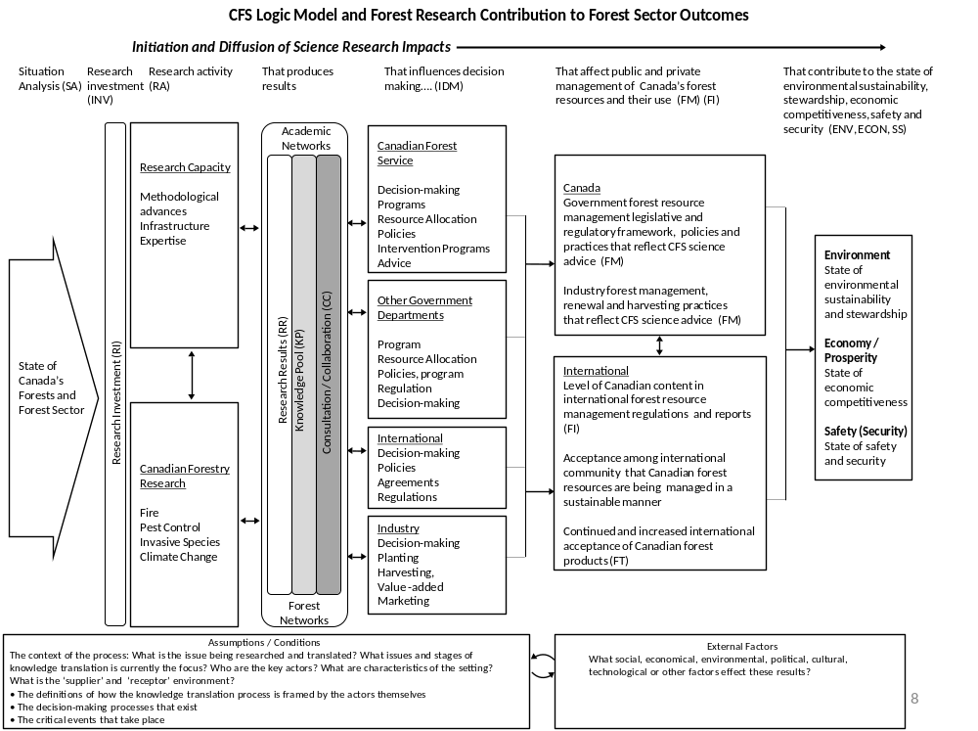
CFS Logic Model of Wildland Fire Research Contribution to Forest Sector Outcomes

Slide 23
Summary and Conclusions
Arriving at a comprehensive theory of change for RTD and innovation is important
Progress is being made
We have a way to go to understand the parts as well as the whole system
A RTD Logic model repository can help us to move forward.

Slide 24
Thank you for your attention.
See RTD TIG website from AEA TIG information page
Contact me at
gretchen.jordan@comcast.net

Slide 25
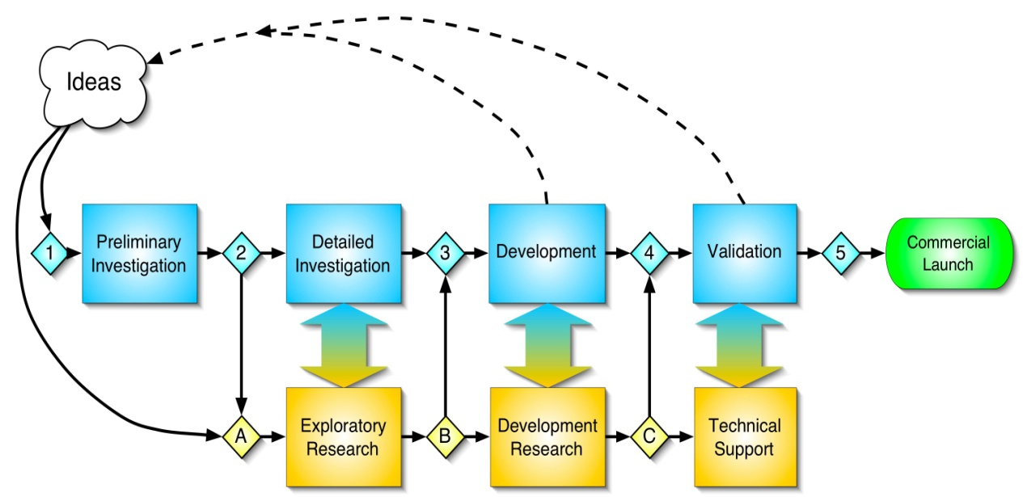
A technology development view
Connectivity and Throughput
6
Production,
Refinement
Diffusion and use
Micro,
meso, macro
impacts
9
10
8
7
Marketing R&D, Quality R&D
Engineering & manufacturing R&D
Source: G. Jordan, 2007. Modified from R. Cooper/ Exxon’s Stage Gate, Hage & Hollingsworth’s Idea Innovation Network

Slide 26
Theory of Diffusion of an Innovation
Socio-cultural/market environment
• Market structure
• Market segments
• Prior practice
• Culture and norms
• Innovativeness
Communication field
• Broadcast
• Contagion
Feedback
Awareness
Persuasion
Decision
Implementation
Confirmation
Adoption
Continued adoption
Later adoption
Characteristics of the decision-making unit
Product Characteristics
• Adopter type
• Personality type
• Communication behavior
• Socio-economic status
• Relative advantage
• Compatibility
• Complexity
• Trialability
• Observability
Rejection
Discontinuance
Continued rejection
Source: Everett Rogers 1994 as modified by Innovologie, LLC. 2005

Slide 27
Multiple levels of influence and assessment within an emergent RTD system
Macro
(nation,
State)
IMPACT
Ideas, Tools, People,
Transitions to application
New product development & diffusion
Public goods, policy
Private goods, competitiveness
Socio-economic Institutional change
Resources, Management, Relationships, Incentives, Institutional Blocks, Influence
Meso
(Sector,
RTD
Area)
Science research & education
Technology & product development & diffusion
Governmental Institutions
Business Infrastructure
Socio-economic Institutions, Norms
Resources, Management, Relationships, Incentives, Institutional Blocks, Influence
Draft 10/20/2005
G. Jordan
Micro
(Orgn.,
network
level)
Connectivity and Throughput
6
Production,
Refinement
Diffusion and use
Micro,
meso, macro
impacts
9
10
8
7
Marketing R&D, Quality R&D
Engineering & manufacturing R&D
INPUTS
External
Influences
Resources, Management, Relationships, Incentives, Institutional Blocks, Influences
Science research & education (General & specific)
- Macro
Meso (discipline, problem area
Micro (org., lab, individual)
Technology & product development & diffusion (Industrial & public)
- laboratory & operational)
- Supporting technologies (infra-technologies, generic, & specific)
Governmental Institutions,
Policies
multi-national
national
regional, state, local
Business Infrastructure
Sector level (meso)
Firm (micro)
Institutions, Norms
-Economic
-Socio-cultural
Pieces borrowed from R. Cooper/ Exxon, E. Rogers, Arnold & Kuhlmann, Hage & Hollingsworth, G. Tassey

Slide 28
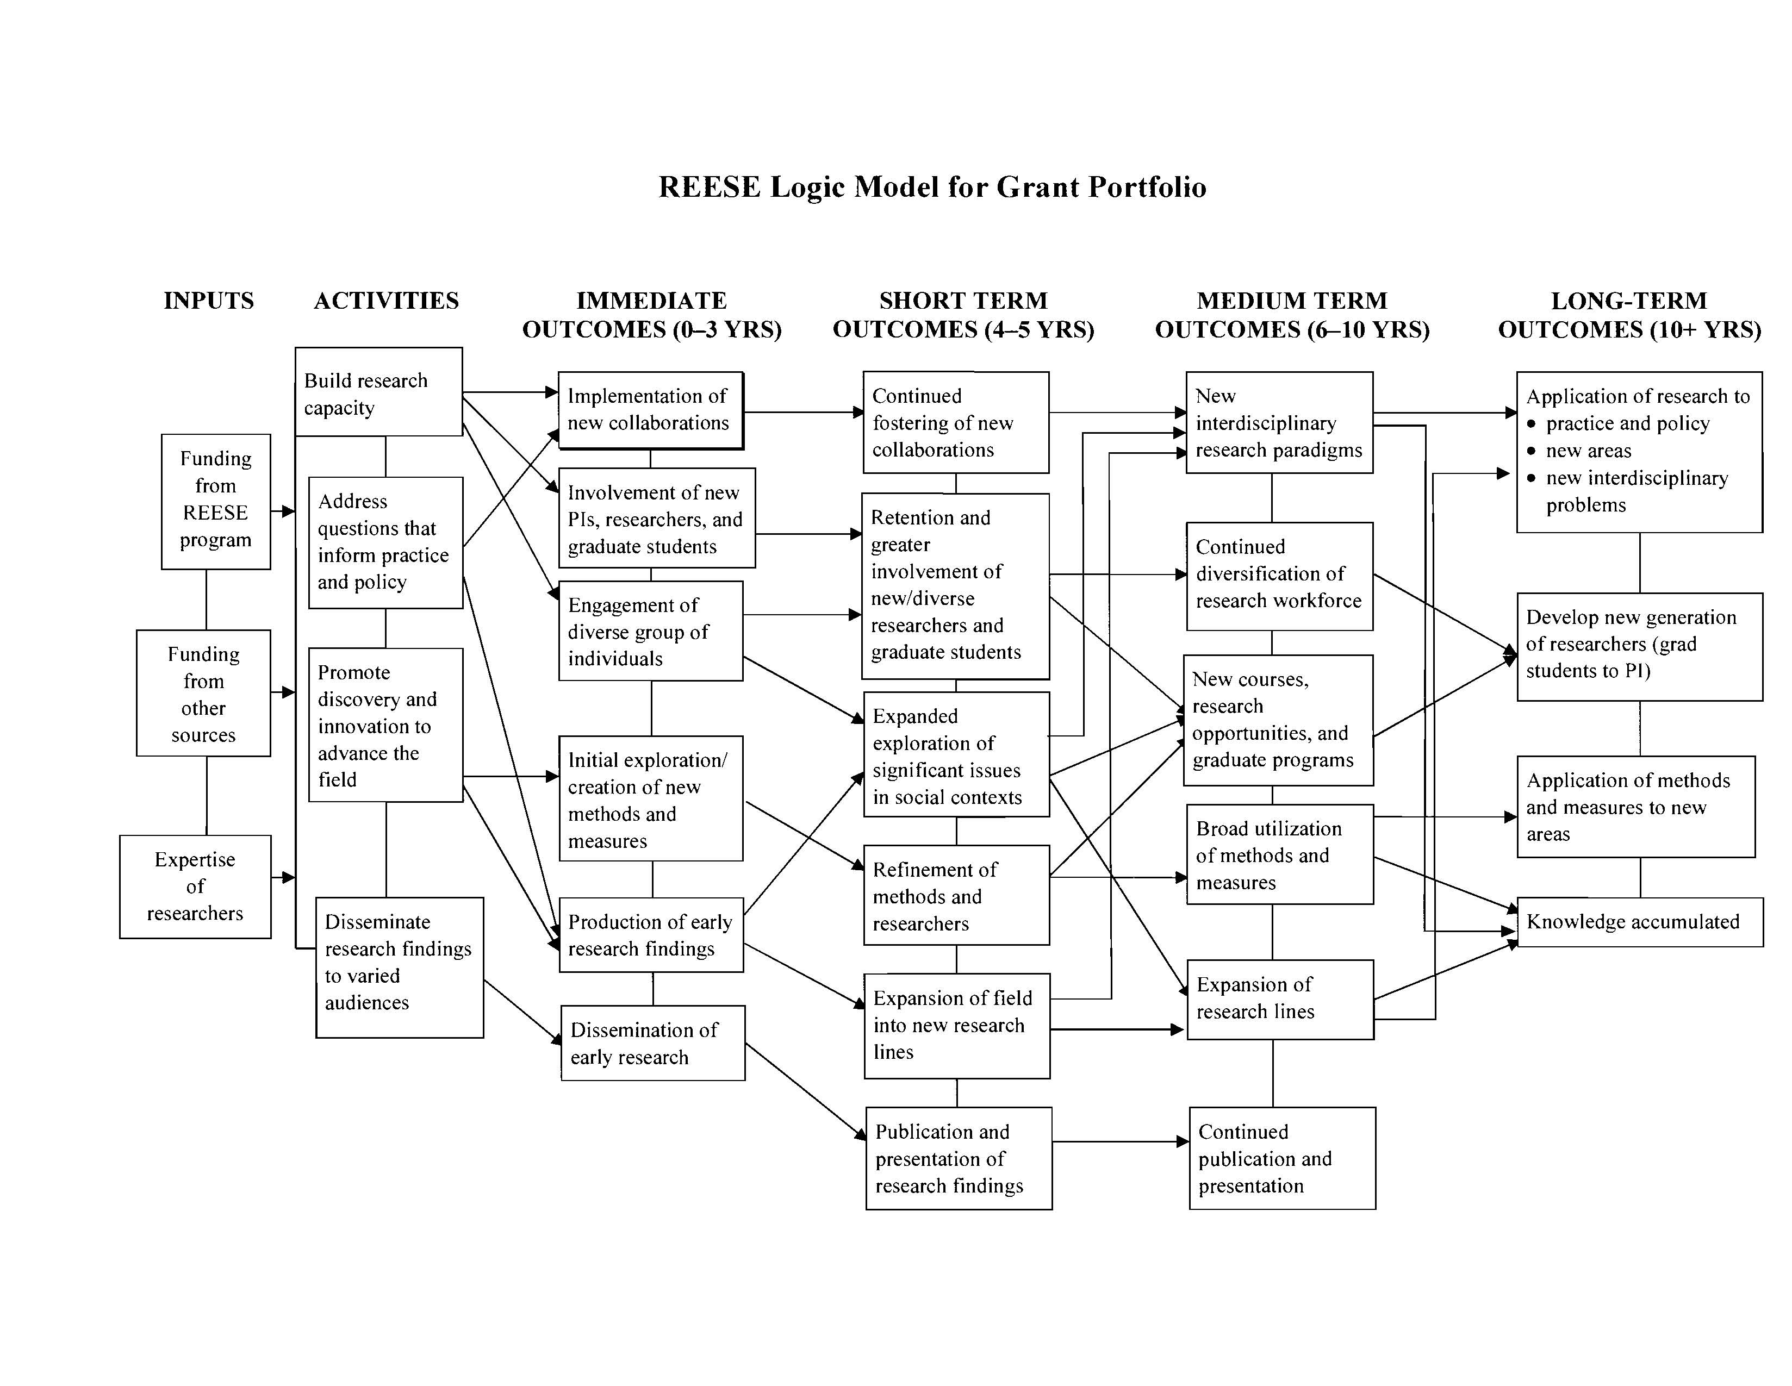
REESE Logic Model – Basic Science
Source: Frechtling for NSF

Slide 29
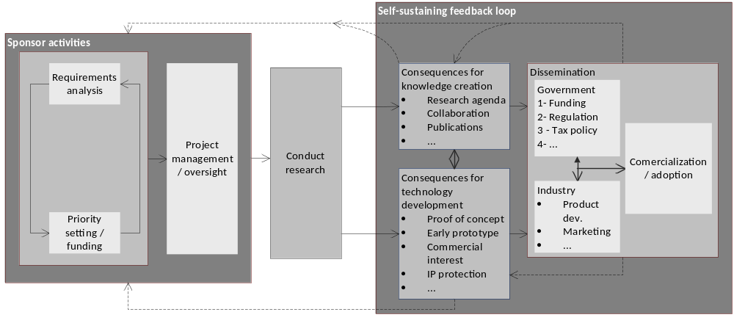
Program level, with feedback loops to priority setting
Source: J. Morell for DOT

Slide 30
Rand-NIOSH. Helping researchers think through how their work contributes to organizational goals
Research Program
For/ With
Results Chain
Resources
Activities
Outputs
Customers/
Partners
Short-Term
Outcomes
Intermediate
Outcomes
Long-Term
Outcomes
(Includes
Transfer,
Use)
Customer Decisions & Actions
Strategic
Objectives
Strategic Goals
Outcome Worksheet
Strategic Goals | Intermediate Outcomes | Short term outcomes | Customers/ Partners reached | Outputs | Activities | Resources
Modified from RAND- NIOSH
G. Jordan, February 2011
Notes:
DEMONSTRATING AND COMMUNICATING RESEARCH IMPACT
Preparing NIOSH Programs for External Review
Valerie L. Williams | Elisa Eiseman
Eric Landree | David M. Adamson
Copyright 2009 RAND Corporation

Slide 31
NYSERDA R&D Portfolio Logic – Revised DRAFT
Inputs:
Funds, staff, NYSERDA competencies, partnerships
NYSERDA Select & Manage R&D Projects to:
-drive portfolio changes over time to respond to current needs, and
-Provide public benefits
Draft 07/18/2004
Activities
Policy Research
Product Development
Demonstration
Pre-deployment
Inform policy
& R&D community
Study, Prove
Concepts
Develop new or improved product
Test &
improve products
Demonstrate products, inform markets
Educate, provide incentives to supply & delivery
New knowledge:
-papers, articles
-data
-Intermediate scale prototypes
Performance/cost specifications improving
- Data from tests
- Establish standards
Hands on experience (industry)
Feedback to R&D
- Data from tests in different context
Feedback to R&D
- Visibility & data from showcases
Training, certification
Production incentives
Innovative designs
Outputs
White papers, workshops;
Etc.
Outcomes
Informed policies & programs;
R&D opportunities & standards identified, publicized
Dissemination builds common knowledge base
Lab prototypes
-Future R&D & product options
-Investment/interest growing
-Commercial scale product developed
-Potential demonstrated
Product proven/ introduced in market
Producers & consumers see value
Business infrastructure supports the product
Policy and Product development and pre-deployment process (5-10 years)
Firms have credibility & with co-funders acquire capital and distribution channels
- New
- Accelerated
- Expanded
Products manufactured as replacement, stand alone, or part of system and purchased by early adopters [and early majority?]
Products in the areas of
Clean energy generation
Energy storage, distribution, & load management
Reduced energy use
And related to these are: Emission reduction, Lower cost of compliance, Manufacturing and job creation
External Influences:
Cost, Performance of existing technologies; Industry willingness to take risks; Uncertainty of R&D; Energy prices; Government policies

