Slide 1

The Workplace Community
#CNGSanDiego
Notes:
Title Slide

Slide 2
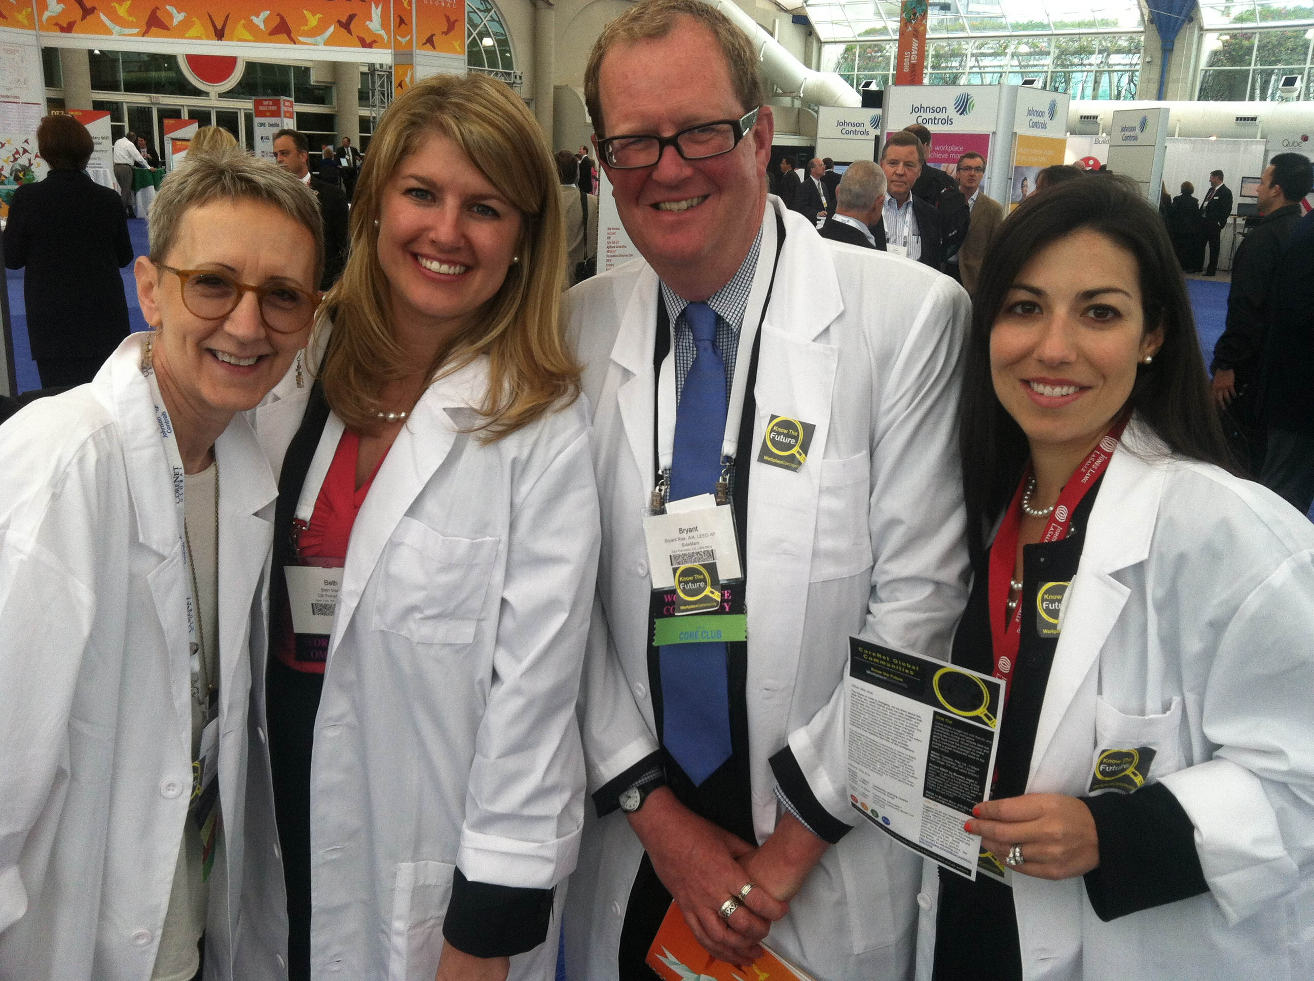
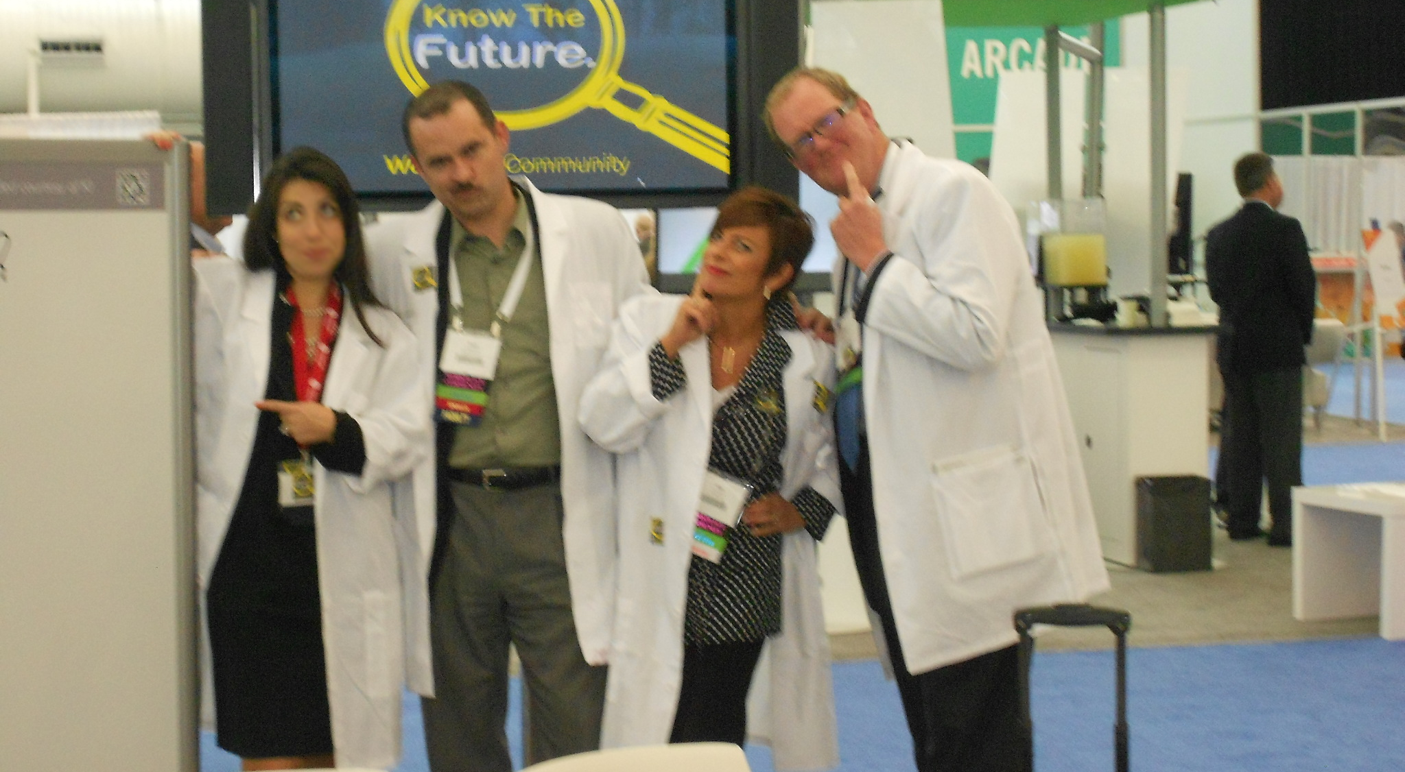

Slide 3
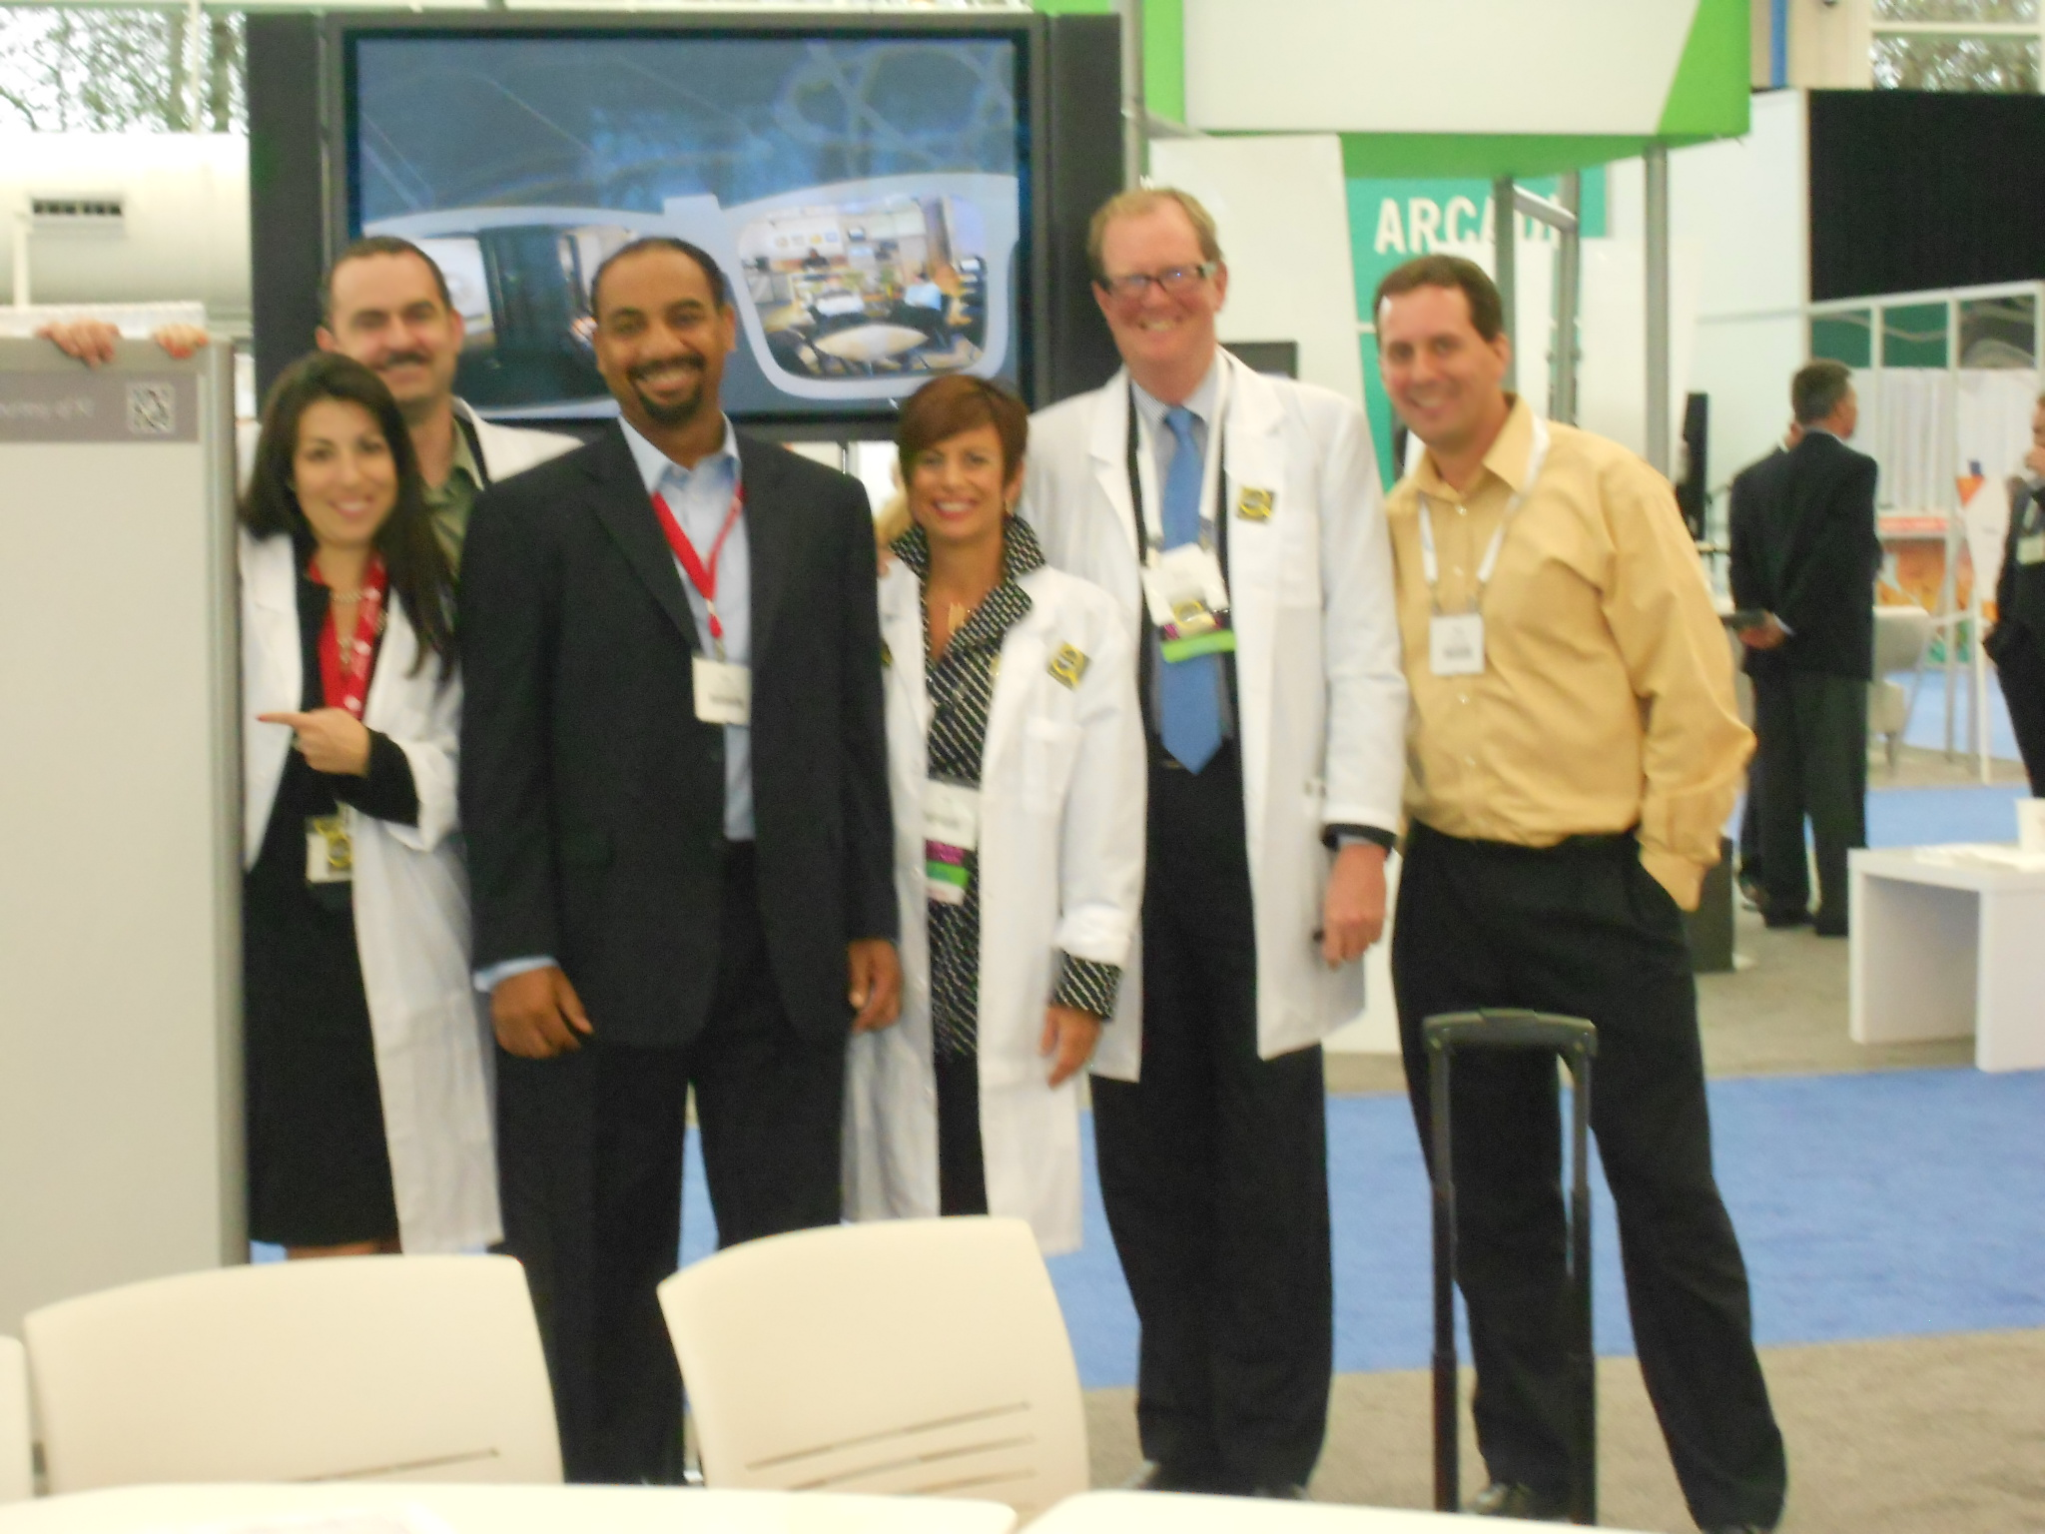
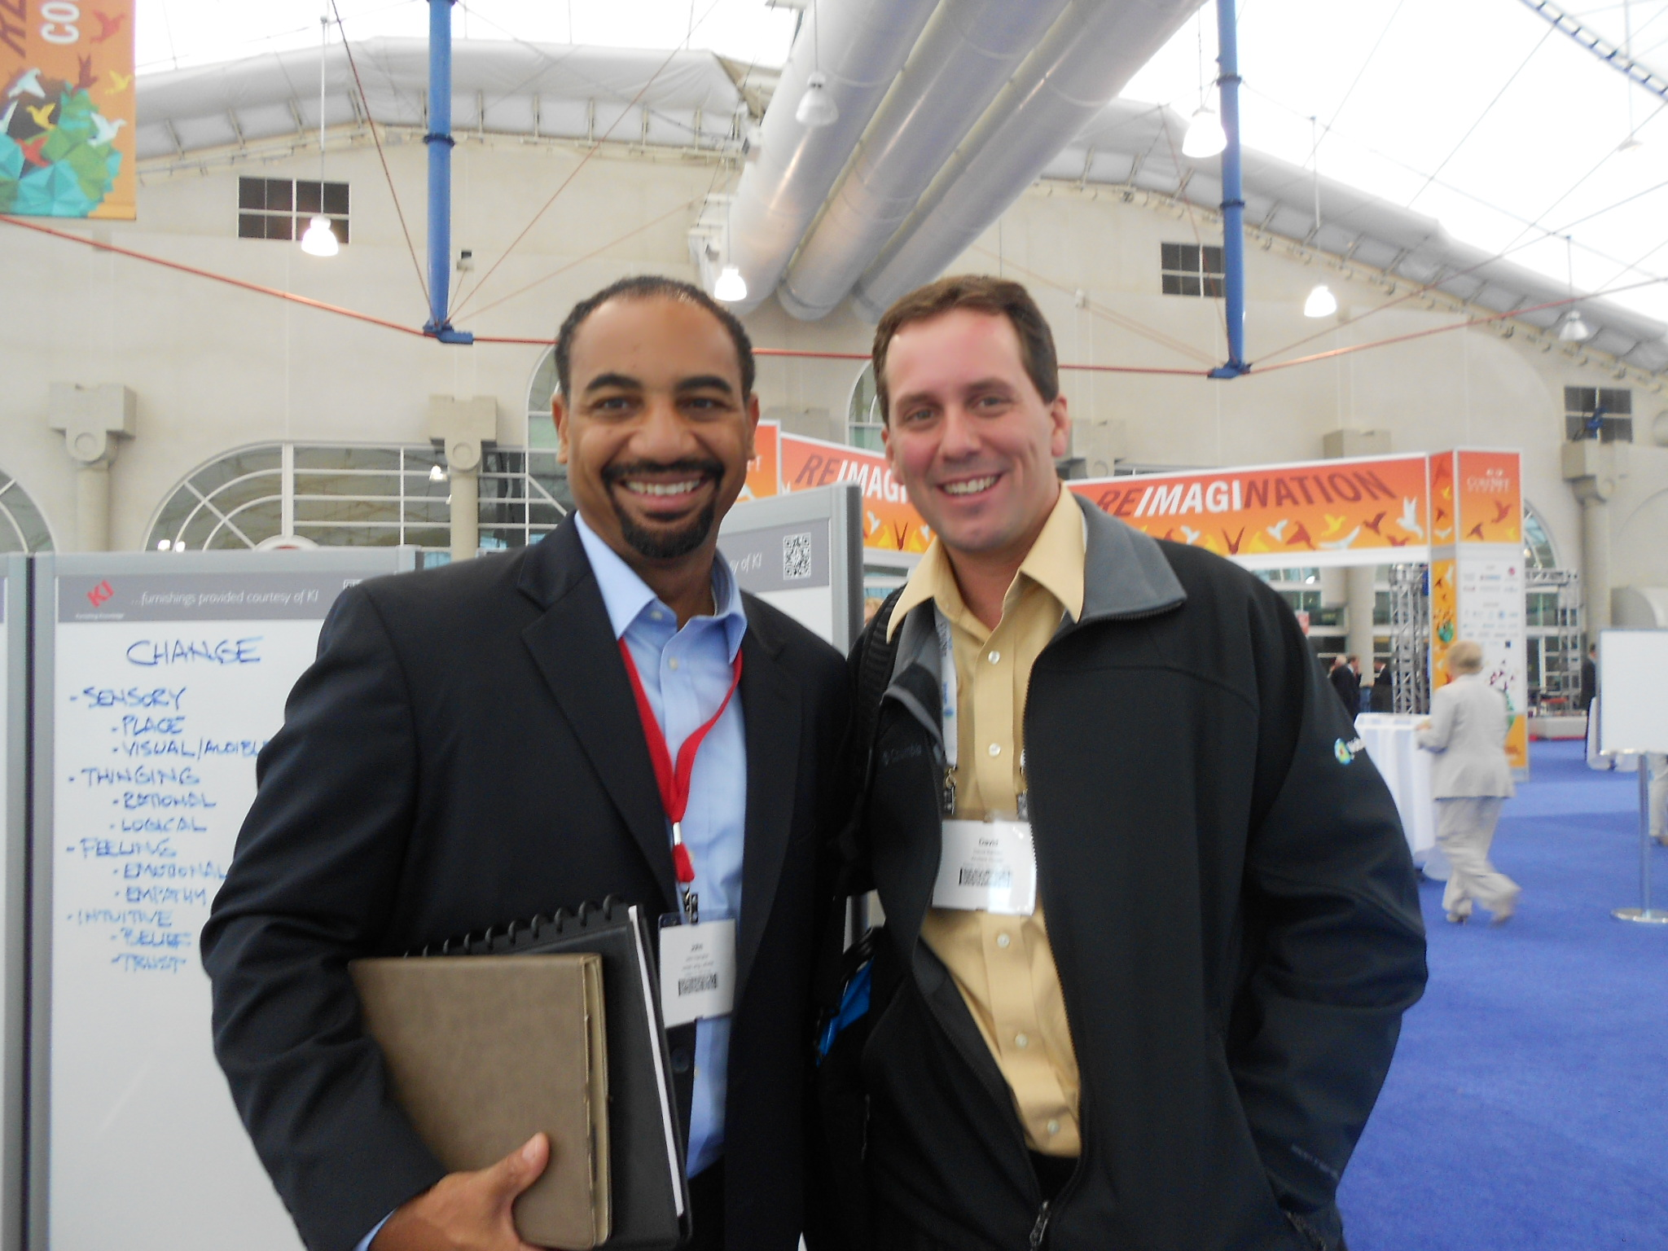

Slide 4
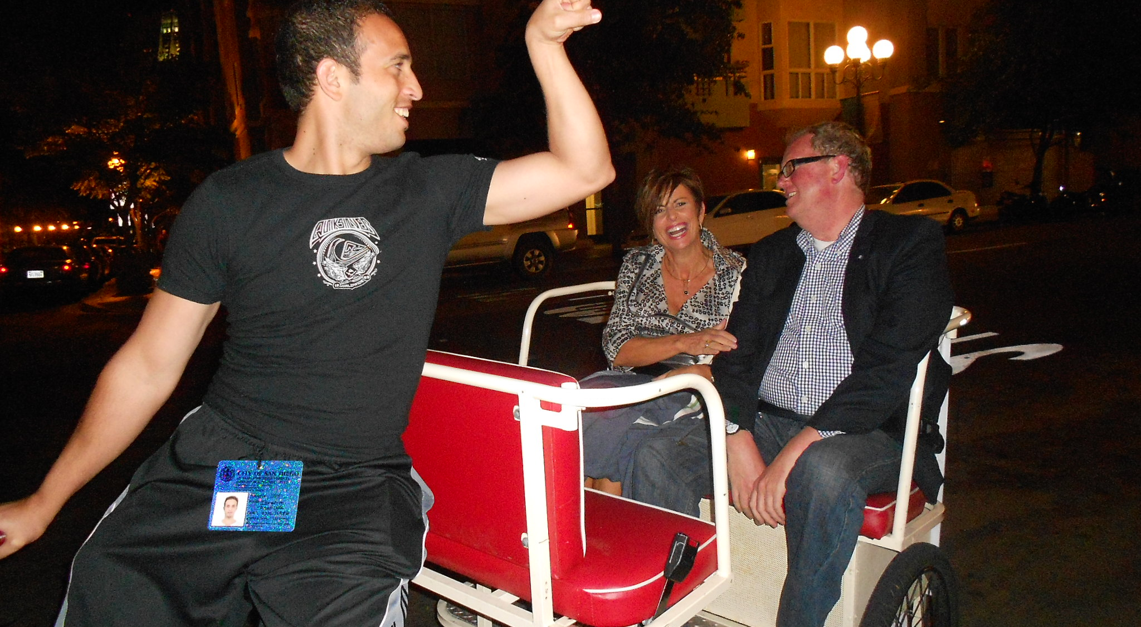

Slide 5




Thank You to our Sponsors
Gold Level Sponsor
Silver Level Sponsor
Bronze Level Sponsors

